Slide 1
Investigating
21/02/2024
Year 7 Science

Slide 2
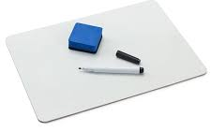
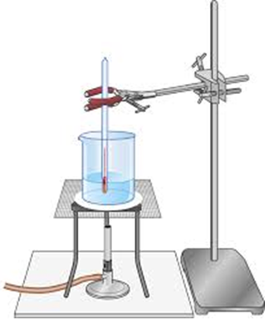
Review
How can we tell if the gas tap is off?
Write one rule about Bunsen burner safety.
Draw this as a scientific diagram

Slide 3
Learning Intentions
Conduct experiments, ensuring safety and ethical guidelines are followed

Slide 4
Success criteria
Safely light a Bunsen burner
Investigate different colour flames
Describe the Safety Flame

Slide 5
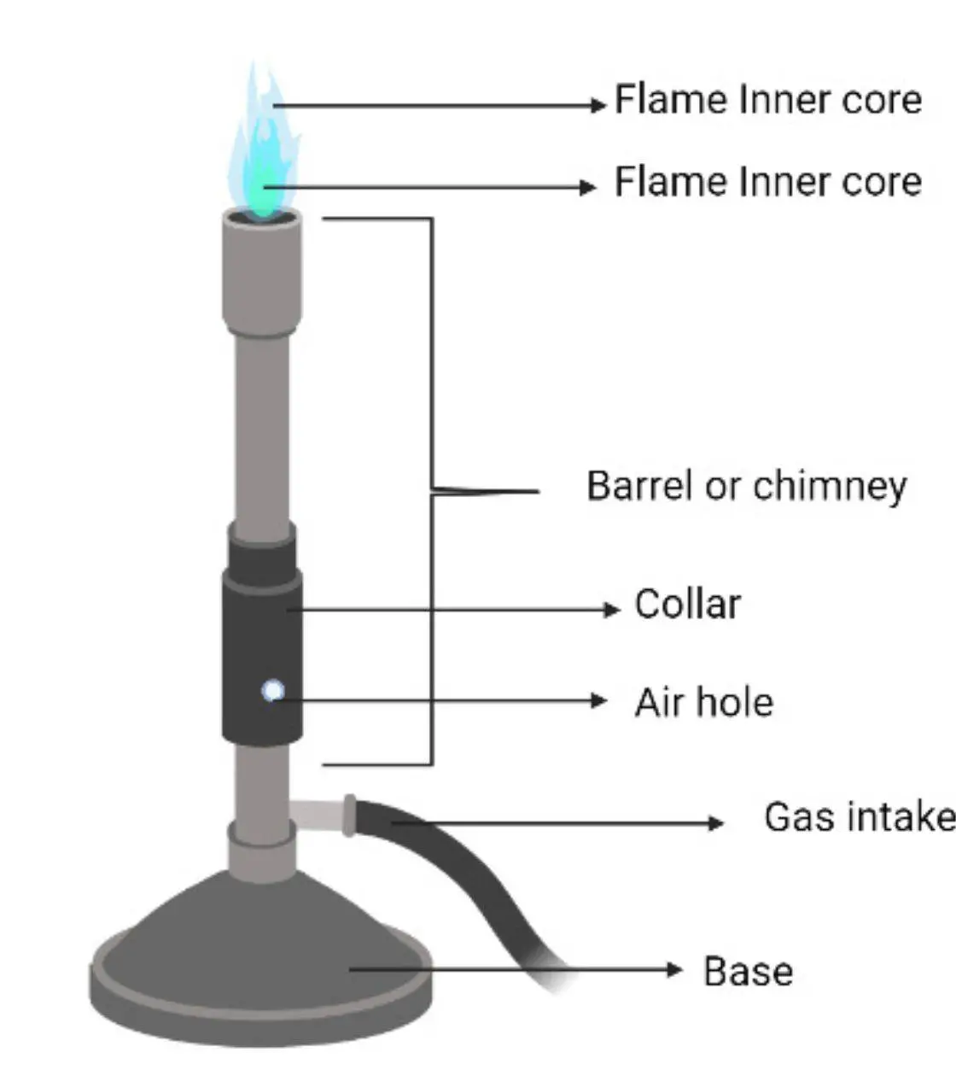
Lighting a Bunsen burner
Airhole | Flame colour | Other observations
Closed
Half closed
Open

Slide 6
Investigating the flame
Part A: Hot or Cold
Part B: Clean or dirty

Slide 7
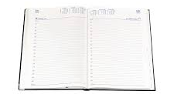
Diaries
Homework sheet – laboratory equipment
Due Monday 12 Feb

Slide 8
Success criteria
Work together to solve problems
Record information in tables
Explain your reasoning to others

